Slide 1
Space Invaders via unity 3d
A guide into creating a Space Invaders Game
SMc10330 – Maths and Science for Computer Games

Slide 2
The Bundle
Download the bundle provided on Moodle
This link contains some assets that we would need in these tutorials
Art files
Sound files and
Unity packages

Slide 3
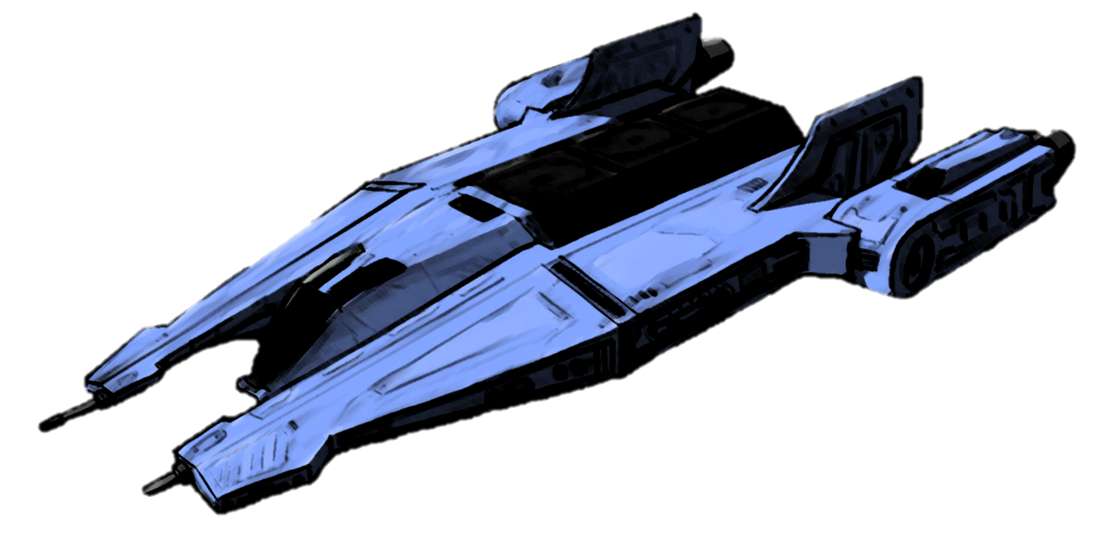
The Spaceship

Slide 4
Overview
Making a cube
Previewing your game
Controlling a cube
Drawing a spaceship instead of a cube

Slide 5
Making a cube
Place the cube that you have in your scene at the origin
Go to the inspector view and set the position trans form of the cube so that:
x=0
y=0 and
z=0
Task: Add a Rigidbody Component to the cube:
Choose the Components menu
Select the Physics submenu and then
Click on RigidBody.
Uncheck the Gravity option

Slide 6
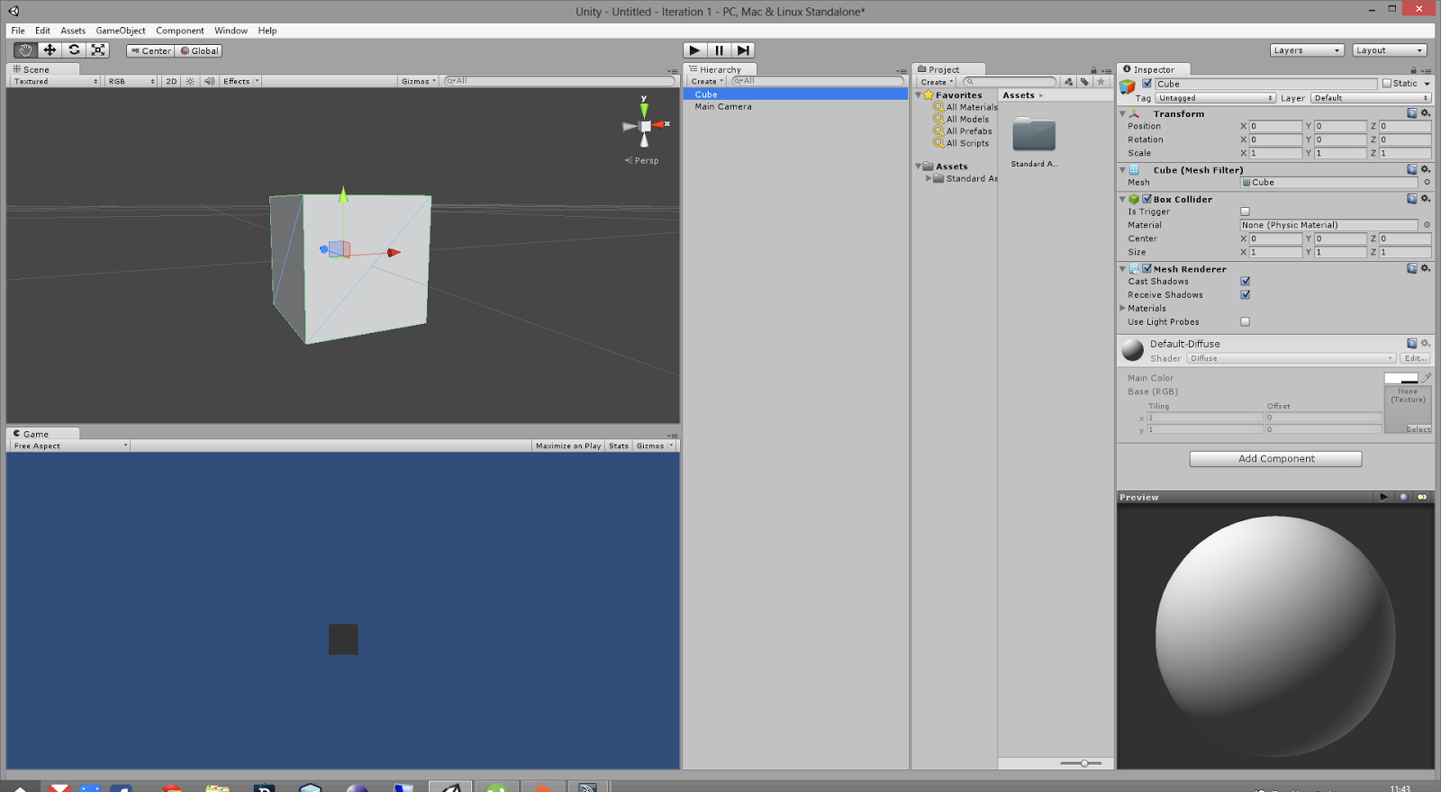
Previewing your game
In order to preview your game you can press the play button which can be seen in the top middle section of your unity editor.
Notice that you can also pause your game in the editor at any stage by pressing the pause button

Slide 7
Controlling your Cube
We would like to control our cube via the keyboard
We want to move the cube:
To the left when the left arrow is pressed
To the right when the right arrow is pressed
We can add this functionality using scripts
i.e. Programming

Slide 8
Creating our 1st Script
In your Project View create a folder called Scripts within the folder called Assets.
Create a new C# script in that folder, call it “Player”, and then double click on the new script.

Slide 9
What our player script should look like before editing it
using UnityEngine;
using System.Collections;
public class Player : MonoBehaviour {
// Use this for initialization
void Start () {
}
// Update is called once per frame
void Update () {
}
}

Slide 10
Exercise
In your script declare a public variable speed.
Note: You might not know the actual value to initialize it, but once you do it public, it can be edited from the Inspector by the game designer!

Slide 11
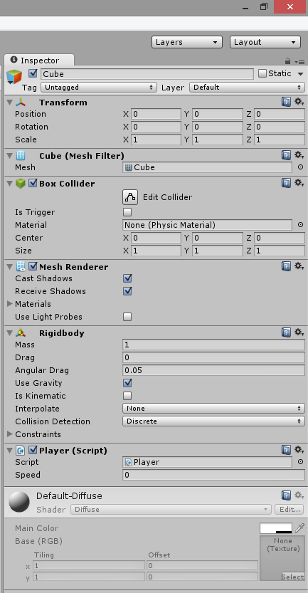
Notice
using UnityEngine;
using System.Collections;
public class Player : MonoBehaviour {
public int speed;
// Use this for initialization
void Start () {
}
// Update is called once per frame
void Update () {
}
}

Slide 12
Detecting Input
In Unity we have a class which we can use to ask what is being pressed.
The same class can be used to communicate with the keyboard, mouse, touch screens and gamepads.
To check if the left key is currently being pressed all you need to do is check for it every frame in the Update() method by using a simple if statement.
If the left arrow is being pressed then we need to modify the position of the cube. In our case we want it to move along the X axis.

Slide 13
Update the Player script to look like:
using UnityEngine;
using System.Collections;
public class Player : MonoBehaviour {
public int speed;
// Use this for initialization
void Start () {
}
// Update is called once per frame
void Update () {
if(Input.GetKey(
KeyCode.LeftArrow))
{
transform.Translate(
-speed,0,0);
}
}
}

Slide 14
Note about Detecting Input
Remember to set the speed to some value, either programmatically or from Unity.
Any value set from Unity overrides the value in your script.
A problem with the code above is that it will not be frame rate independent
if the frame rate changes the game state will be updated erratically with a jerky animation.
Make it frame rate independent by multiplying by Time.deltaTime which is the time it took complete the last frame in seconds.
Now the speed variable will represent how much the cube will travel left or right in terms of pixels per second.
You might want to bump up the value.

Slide 15
Exercise
Try to apply the same idea for when the right arrow is pressed

Slide 16
Adding some polishing
Let us make the cube seem as though it is hovering in place.
Create another public float variable called hoverAmplitude.
A suitable value for this hoverAmplitude variable would be 0.5.
This variable would control how much the cube would oscillate from a given height.
We can mimic this oscillation using a simple sine wave function.

Slide 17
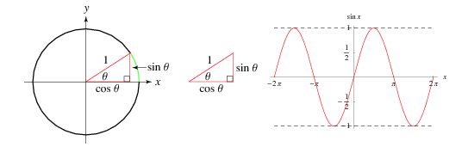
The Sine function

Slide 18
Controlling the Oscillation
In order to control this sine wave function we need to also add a:
private float angle
public float deltaAngle
public float frequency.
Set the angle variable to 0, deltaAngle to 0.796f and the frequency to 0.2f.

Slide 19
Making sure that the cube does not exit the screen.
Since we are constantly editing the position of the cube, it would be a good idea to keep track of the player’s X position via some friendly name.
Whenever we would need this variable we would just call this variable.
We can then use this variable for the player’s X position in order to stop him from exiting the screen.

Slide 20
Newly updated Player script (1)
using UnityEngine;
using System.Collections;
public class Player : MonoBehaviour {
public int speed;
private float angle = 0;
public float deltaAngle = 0.796f;
public float frequency = 0.2f;
// Use this for initialization
void Start () {
}
}

Slide 21
Newly updated Player script (2)
// Update is called once per frame
void Update () {
float positionPlayerX = transform.position.x;
if (Input.GetKey(KeyCode.LeftArrow) && positionPlayerX >= -11.5f)
{
transform.Translate(-speed * Time.deltaTime,0,0);
}
if (Input.GetKey(KeyCode.RightArrow) && positionPlayerX <= 11.5f)
{
transform.Translate(+speed * Time.deltaTime,0,0);
}
transform.Translate(0, hoverAmplitude * Mathf.Sin(frequency * angle) * Time.deltaTime, 0);
angle += deltaAngle;
}
}

Slide 22
Exercise
Have a play with finding the right values for the variables we have created.
One great advantage is that you can change the values while the game is running, but a downside is that when you stop the game, the values are not saved.
So you will need to remember what you modified before stopping the game.

Slide 23
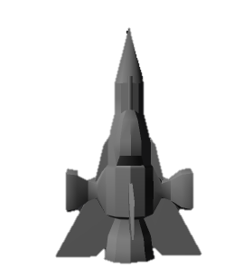
Drawing a Spaceship instead of a cube
Having a cube as your spaceship is not really looking great.
Let’s try drop in some model.
First create a new folder in your Project, under Assets called Models.
Within your bundle folder you should find a fill called ‘Spaceship.fbx’.
Drag this file into the newly generated folder.

Slide 24
Drawing a Spaceship instead of a cube (2)
Once you have added your spaceship to your Models folder, drop it in the scene, and scale it 10x10x10.
Place it at position (0,-5.8,0).
Delete the Player cube we had done.
Apply the Player script to our spaceship in the hierarchy.
Do not forget to attach a RigidBody to the spaceship and to turn off its gravity. Rotate it, if necessary, until it’s aligned pointing up.

Slide 25
Quick note on 3D files
Sometimes you might have 3D models which use different orientations for their axes, therefore you might get some strange behaviour when transforming (translating, scaling and rotating) the object.
It is good practice to place any 3D model that you have into an empty game object once you have correctly oriented it.

Slide 26
Exercise
Go to the Game Object menu
Select “Create Empty”.
Place your spaceship into this empty game object. (Before you do this make sure that your spaceship is placed at the origin).
Rename the empty game object as Player.
Remove the script from the spaceship and attach it to your Player game object. (Make sure that you reset all of your variable values).

Slide 27
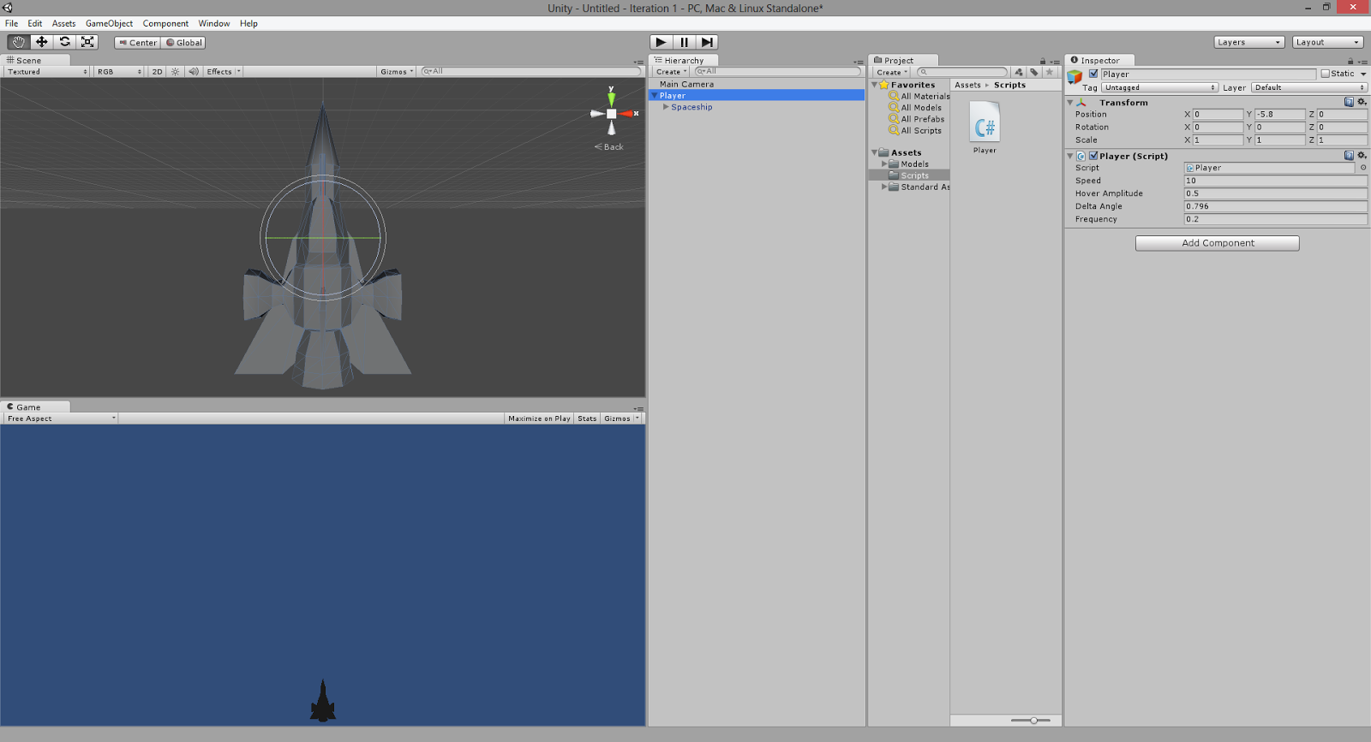
Result

Slide 28
Exercise – Part 2
Play around with the Directional Light that you already have in your scene so that you would have the optimal shading on your spaceship in the Game View.
You also will want constraint the movement to only X Y, so find the RigidBody component and add it to the spaceship
then tick the Z position constraint and also the X, Y and Z rotations.
Make sure that the gravity variable is turned off

Slide 29
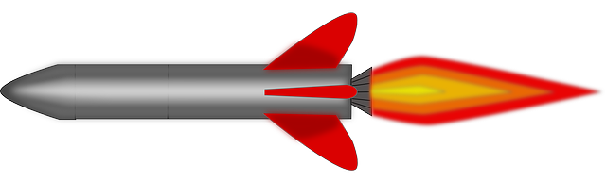
The Missile

Slide 30
Overview
Firing Missiles
Instantiating Prefabs
Adding motion to the missile
Fire Rate
Destroying missiles after some time

Slide 31
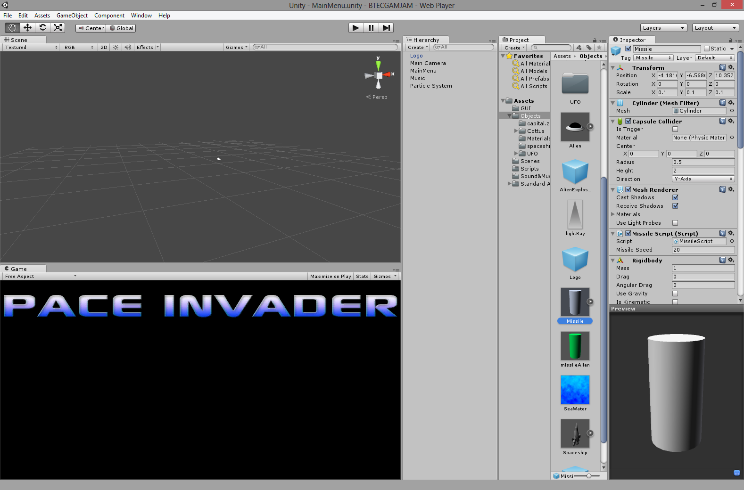
Firing Missiles
We need to instantiate bullets at runtime when the player presses space bar.
Let’s create a simple model for the bullet.

Slide 32
Create a cylinder with a radius of 0.5 and a height of 2, call it Missile and position it in front of the spaceship with z set to 0.
Adjust the scale accordingly so it makes sense that it’s a missile (0.1,0.1,0.1)

Slide 33
Firing Missiles
We need to make this missile as a template.
Think of a class in programming.
In Unity we do this through prefabs.

Slide 34
Create a new folder called Prefabs.
In this folder create a new Prefab by doing a right click on the folder, Create->Prefab.
Drag the Missile object into this prefab. You can then delete the object from your scene.
Now we can drag as many bullet prefabs to the scene, but actually we want to create them at runtime.

Slide 35
What our player script should look like before editing it
Place the following in your Player script Update() method.
if(Input.getKey(KeyCode.Space))
{
Fire();
}

Slide 36
Instantiating Prefabs
In the Fire() method we need to somehow tell it to instantiate our prefab.
To do this, the script needs to know which prefab to instantiate.
So create a public GameObject missile instance variable.
We then need to tell the Fire() method what we are going to fire. So we need to pass it the missile GameObject as a parameter.
Therefore the Fire() method becomes Fire(missile). And then add the following to the Fire() method:
Instantiate (missile, gameObject.transform.position, gameObject.transform.rotation);

Slide 37
Instantiating Prefabs
In the code we are basically instantiating a bullet at the same position and rotation as the spaceship, but offset by some value to be coming out from the front of the spaceship.
After saving your script, go back to Unity, select the player object in your scene and drag the Missile prefab to the Player script’s slot for Missile Prefab.

Slide 38
Instantiating Prefabs
You should notice at least two things.
What are the problems?

Slide 39
Adding Motion to bullet
Try creating a script that moves the missile upwards when it is instantiated.
Remember to drag the script onto your Missile prefab and also to set missileSpeed in Unity. You could always provide a default value on your script. A value of 20 would be ideal in this case.

Slide 40
Fire Rate
If you keep on pressing the space, every frame it’s creating a missile.
We want the spaceship to have a fire rate which can be easily tweaked by the game designer.
That’s easily done by creating a public instance variable fireRate.

Slide 41
Fire Rate
Can you come up with some code so that the Fire() method will take the variable into consideration.
What you need to know is that you can get the time elapsed by doing Time.time

Slide 42
Fire Rate
public float fireRate = 5;
private float timeBetweenShots;
float nextFire;
void Start () {
timeBetweenShots = 1/fireRate;
nextFire = Time.time;
}
...
private void Fire(GameObject missile)
{
if (Time.time > nextFire)
{
Instantiate (missile, gameObject.transform.position, gameObject.transform.rotation);
nextFire = Time.time + timeBetweenShots;
}
}

Slide 43
Destroying missiles after some time
Another issue you should have spotted is that missiles continue accumulating. They never die out. We can easily add this.
To destroy the whole object just call Destroy(gameObject).
There is an overloaded Destroy() method which not only takes a GameObject as a parameter but also the time it would take to die.
This means that we could make each and every missile destroy itself after some time.
To do this add use the Destroy() method within the Start() method of you Missile script.

Slide 44
Destroying missiles after some time
Implement the timed destruction of bullets.

Slide 45



Creating Aliens

Slide 46
Overview
Creating Aliens
Creating spawn point for the aliens
Creating an Alien Manager
Tags
Game Logic

Slide 47
Creating Aliens
So far it’s not really an interesting game. We need to add some aliens to the scene.
We won’t use cubes for our aliens. Drag and drop the UFO model from the bundle to your Models folder.
Drop the model into the scene and scale the model accordingly: 0.5 for each axis should be fine.
Since we want the alien to be part of the physics simulation, add the RigidBody component and disable gravity. Also add a BoxCollider so collision detection can actually happen. Set the center of the box collider to (-0.2,0.7,0) and set the size of the box collider to ( 3, 2, 1).

Slide 48
Creating aliens
Since we will be using Unity’s physics engine, we don’t want that the collision response to make the aliens change their directions and orientations.
We therefore need to restrict these movements by making sure that under the rigidbody’s Constraints -> Freeze Positions and tick all the constraints in the X, Y and Z axes for position and rotation.
Let’s also create an Alien prefab in the Prefabs folder, and drag your alien found in your scene into your new prefab.
Now you can delete the instance in your scene, and we will continue to modify the prefab.

Slide 49
Creating aliens
Create a new script for our Alien. Remember to rename the class name and also the filename. Associate the script with your prefab using drag and drop.
Whenever we want to instantiate an alien we would like to set up:
a random time for it to start firing
a random fire rate
we also want to be able to update the score whenever an alien gets destroyed
update the number of enemies that are left so that the game knows when the player has won or lost the game.
Let us start off by concentrating on the alien and later on we shall worry about the game logic and the score. So in the Start() method we need to add some code.

Slide 50
Creating aliens
public GameObject missileAlien;
public float fireRate;
float nextFire;
float firstFire;
void Start()
{
firstFire = Random.Range (10, 70f);
fireRate = Random.Range (20f, 30f);
nextFire = Time.time + firstFire;
}

Slide 51
Creating aliens
Just as we have done for the player, let us create an alien missile. In order to do this one can reuse the missile prefab.
Drag this prefab onto the scene and edit its colour so that we would be able to distinguish it from the player’s missile.
In order to change the missile’s colour we need to add a new material to it… Try to do this yourself
Green should work well in this case.
Once done save it to a new prefab called Alien Missile.

Slide 52
Creating aliens
We now need to add code in order to make our alien fire its missiles.
This again should be very similar to the code that we have already created for the Player script.

Slide 53
Creating aliens
void Update ()
{
AlienFire (missileAlien);
}
void AlienFire(GameObject missileAlien)
{
//when the world time is greater than the timer set by the script shoot missile
if (Time.time > nextFire)
{
//create missile
Instantiate (missileAlien, gameObject.transform.position, gameObject.transform.rotation);
//Set next timer for the player to be able to fire
nextFire = Time.time + fireRate;
}
}

Slide 54
Creating spawn point for the aliens
When we play the classic space invaders, happens is that a wave (line) of enemies is spawned.
We also see that the enemies move from one side of the screen to the other. Once the whole line reaches one side or the other, then they move down a line all at once.
We are now going to try to emulate this behaviour ourselves. In order to do this we would need to keep track of several variables being the alien’s speed, and the number of aliens that are going to be spawned.
We also need to know which game object we are going to instantiate

Slide 55
Creating spawn point for the aliens
We therefore need to have these following public variables:
public int numOfAliens = 5;
public GameObject Alien;
public float speedAlien = 4f;

Slide 56
Creating spawn point for the aliens
Once that is done, we then need to instantiate the number of aliens that we need for this spawn of aliens. Therefore we need to add this following code:
void Start ()
{
CreateAliens (Alien);
}
void CreateAliens(GameObject Alien)
{
for (int i = 1; i<= numOfAliens; i++)
{
GameObject alien = Instantiate (Alien, new Vector3 (i*2f, 0, 0) + gameObject.transform.position, gameObject.transform.rotation) as GameObject;
alien.transform.parent = gameObject.transform;
}
}

Slide 57
Creating spawn point for the aliens
What we are doing with the above code is that we are creating as many aliens as specified and then we are parenting these aliens to the spawn point.
This means that when we move the spawn point, we would also move the aliens.
This would help us so that all the aliens would move uniformly according to their spawn point and thus remove the possibility of any anomalies that might be caused if we had to move each and every alien one at a time.

Slide 58
Creating spawn point for the aliens
The next thing that we need to do is that we need to control our aliens so that they move from side to side.
Since our aliens are now parented to their spawn point, the only thing that we would need to move is the spawn point.
The aliens would in turn move in the exact same way as we shall specify for the spawn point.

Slide 59
Creating spawn point for the aliens
Up to this point in time, we have always used the Update() method in order to move our objects around.
However there is one problem with the Update() method and that is that it is called at irregular intervals as it is called once per frame.
A frame might take different times to draw; depending on the number of artefacts that need to be rendered at any given point in time.
Since the movement of the aliens is critical to the game, we need to calculate their movement at regular intervals.
In order to do this, we would use the FixedUpdate() method rather than the Update() method.

Slide 60
Creating spawn point for the aliens
We therefore would need to add the following code to our script.
void FixedUpdate ()
{
gameObject.transform.Translate (speedAlien * Time.deltaTime, 0, 0);
if(gameObject.transform.position.x <= -1.0f || gameObject.transform.position.x >= -17.0f)
{
speedAlien = speedAlien * -1f;
gameObject.transform.Translate(0,-1f,0);
}
}

Slide 61
Creating spawn point for the aliens
Create an empty game object and call it spawn point.
Attach the script that we have just created onto it and do not forget to attach the alien prefab to your spawn point also.
Save this spawn point as a prefab and then remove it from your scene.

Slide 62
Creating an Alien Manager
For the time being we have managed to create a single set of aliens.
However when we look at the space invaders games we need to have multiple sets of aliens to create a wave that the player would need to deal with!
In order to do this we need to create an Alien Manager script which would be able to handle and create these different lines of aliens.

Slide 63
Creating an Alien Manager
In this case the game designer might want to be able to edit how many sets of aliens are going to be spawned and also the time interval between one set and the next.
The script would also need to know if it is currently spawning a set of aliens and also it needs to keep some sort of track of how many sets of aliens have been spawned.

Slide 64
Creating an Alien Manager
Hence the variables for this script would look as follows:
public int numOfSpawns = 3;
public float timeToSpawn = 3f;
public GameObject spawnAliens;
bool isSpawning = false;
int counter = 0;
Can you explain what these variables are going to be used for in our code?

Slide 65
Creating an Alien Manager
We do not need to set any variables per se when loading up this game object, therefore we could just remove the Start() method altogether.
One thing that we do need to do is Update this object and spawn a set of aliens when a certain amount of time has passed between the last spawn of aliens so that all sets would eventually cascade down upon to the player.

Slide 66
Creating an Alien Manager
void Update()
{
if(counter < numOfSpawns)
{
if(isSpawning != true)
{
isSpawning = true;
CreateAliens();
}
}
}
void CreateAliens()
{
//create aliens
StartCoroutine(WaitForSecondsToCreateAlien(timeToSpawn, spawnAliens));
}
//Wait an amount of time to spawn another set of aliens
IEnumerator WaitForSecondsToCreateAlien(float time, GameObject spawnAliens)
{
yield return new WaitForSeconds(time);
Instantiate (spawnAliens, gameObject.transform.position, gameObject.transform.rotation);
isSpawning = false;
counter++;
}

Slide 67
Creating an Alien Manager
Create an empty game object, called AlienManager
Attach the script that we have just created onto it.
Notice that we would need to hook in the SpawnPoint prefab that we created earlier in order for it to work.

Slide 68
Tags
In order to be able to keep track of what game object is what, one would normally use Tags.
What are tags and why are they used?
Tags are just a form of identification which can be used in order to find game object with the same tag.

Slide 69
tags
Why would one need to find such game objects you might ask?
Well, sometimes certain game objects need to talk to other game objects so that they could trigger an event, but in saying so a game object does not need a direct link to game objects and so that they are permanently stored in memory for whenever they are needed.
If one does this it would make the code a lot more difficult to understand as well as not being that modular.
Therefore what we do is that we create Tags for each object that we have and then we call those objects with certain tags only when needed (such as when updating a score, or reducing the number of lives of the player, or triggering a game over event etc….).

Slide 70
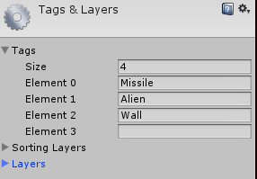
Tags
How does one create tags? Well it is quite simple really.
Select the Alien prefab.
At the top of your inspector window you should find a drop down menu right next to a label marked as ‘Tag’.
Click on the drop down menu and then click on ‘Add Tag’.
Once you have clicked on ‘Add Tag’ you would be able to insert your custom tags.
Add one for Missile, Alien and Wall.
Once that is done then select your left and right walls and set the tag to be equal to ‘Wall’, and then tag your alien and missiles (player and alien missiles) accordingly.

Slide 71
Game Logic
Let’s create an empty game object and also a GameLogic script to associate with this object.
In the Start() method of the GameLogic class we will write the code in order to start the game.
Here we will specify the which game object is the Player, which game object is the Alien Manager, and also how many aliens are alive in our game at any given point in time.

Slide 72
Game Logic
The whole point behind the Game Logic Script is so that we could keep track of what is going on in the game.
There are 3 possible states that the game can be in whist playing.
These states are playing mode, win state and loss state. One wins the game if the player still has lives left and there are no more aliens to destroy.

Slide 73
Game Logic
One loses the game if the player has no more lives. One is still paying the game if there are aliens to destroy and if the player still has a number of lives.
With that respect, we need to keep track of the Player, the AlienManager and how many aliens are left. We shall therefore create said variables and keep track of the Player and AlienManager game object

Slide 74
Game Logic
GameObject Player;
GameObject enemyManager;
int numOfEnemies;
// Use this for initialization
void Start ()
{
Player = GameObject.Find ("Player");
enemyManager = GameObject.Find ("AlienManager");
numOfEnemies = enemyManager.GetComponent<_AlienManager>()
.numOfSpawns * 8;
}

Slide 75
Game Logic
Now, in each frame, we need to check to see if the game has been won or lost.
We will therefore create 2 new methods which would be called in the Update() method within this Game Logic script.

Slide 76
Game Logic
void Update ()
{
CheckForWin ();
CheckForLoss ();
}
void CheckForLoss()
{
if(Player.GetComponent<PlayerScript2>().healthPoints <= 0)
{
Time.timeScale = 0;
}
}
void CheckForWin()
{
//Try to work out this part of the code
}

Slide 77
It would also be a good idea to be able to call a method within the Game Logic script so as to decrement the number of enemies whenever an enemy has been destroyed.
Please try to write the code for this yourself.

Slide 78

Collision Response

Slide 79
Overview
Collision Response
Collision between Alien and Missile
Multiple hits
Explosion

Slide 80
Collision response
When object have a rigidbody, collision detection is done automatically.
You just need to worry on how to handle the collision, AKA collision response.

Slide 81
Collision Between Aliens and Missile
Let’s start with the Missile.
When it hits something it should destroy itself. This is all you need to do
In unity we can destroy an object by using the Destroy() method
We than pass the object we want to Destroy as a parameter
Eg: Destroy(missile); //missile is the gameobject

Slide 82
Collision Between Aliens and Missile
/*OnCollisionEnter is a default method in Unity used in order to detect when a gameObject collides with the gameObject this script is attached to */
void OnCollisionEnter(Collision collide)
{
if(collide.gameObject.tag == "Alien")
{
Destroy (gameObject);
}
}

Slide 83
Collision Between Alien Missile and ship
We need to do something very similar to the missile that the Alien would fire but this time the missile should destroy itself when it hits the player.
To do this we would need to set the player up with the default Unity ‘Player’ Tag and alter the code that we already have in the missile script so that we create yet another script called AlienMissileScript.
The only difference is that the alien missile should travel in the opposite direction of the player’s missile and the tag on the OnCollisionEnter() method should be “Player”.

Slide 84
Collision Between Alien Missile and ship
Set the player tag to ‘Player’
Create a script called AlienMissileScript
Add the OnCollisionEnter(collision collide) method inside the script
Check if the collide.gameObject.tag == “Player”
Destroy(gameObject) withing the if condition

Slide 85
Multiple hits
At the moment the aliens would be destroyed after being hit once.
It might be a good idea to add another feature in the alien script to allow multiple hits.
Try to add the code for this feature in your script

Slide 86
Explosions
Polish is key!
One of the tricks of making a good game is to surprise the player.
For the time being we will use ready made explosions which can be downloaded from http://unity3d.com/support/resources/unity-extensions/explosion-framework
We can create our own particle systems and custom explosions (we will see how in the next chapter)
Import the Detonator.unitypackage by double clicking it so we can add it to our space invaders game.

Slide 87
Explosions
Every time an alien spaceship is destroyed it would be nice if there were some sort of small explosion thus not having the alien disappear into thin air.
Within the Detonator package there are a lot of examples of explosions. Let’s have a play with the explosions first.
In Standard Assets you will find a Detonator folder and within that you will find Prefab Examples. You can drag and drop anyone in your scene. But the most reasonable one for our case will Detonator-Heatwave(Pro).

Slide 88
explosions
You can modify the instance you’ve got. Change size of the 3 and also disable Auto create force so it doesn’t affect the neighbouring game objects.
You should also see 3 Detonator FireBall scripts attached to this prefab. One has the color set to blue, the other magenta and the last on green. Set the size of the ‘blue’ script to 0.7 and the size of the other 2 to be 0.5.
Create a new prefab and call it AlienExplosion and drop the instance you’ve been modifying in there

Slide 89
In our Alien script declare a public GameObject alienExplosion.
For the alien prefab drag the AlienExplosion prefab into the alienExplosion transform.
In order to play the explosion once the alien is destroyed you would need to add this code in the OnCollisionEnter() method in the Alien script:
void OnCollisionEnter(Collision collide)
{
//If missile hits destroy gameObject
if(collide.transform.tag == "Missile")
{
Destroy (gameObject);
Instantiate (alienExplosion,gameObject.transform.position, gameObject.transform.rotation);
}
}

Slide 90
explosions
Create a variant of the explosion and make it green-ish.

Slide 91

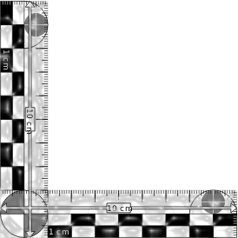
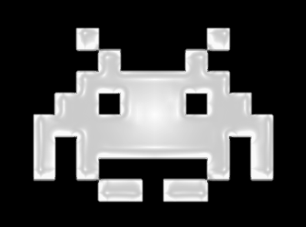
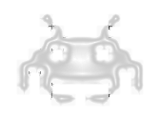
Background and Scale

Slide 92
Background
The environment our game is set in is always extremely important.
The first thing a player will notice is the visuals.
Using a suitable background for our game can be frustrating.
Unity makes the process of changing backgrounds extremely easy

Slide 93
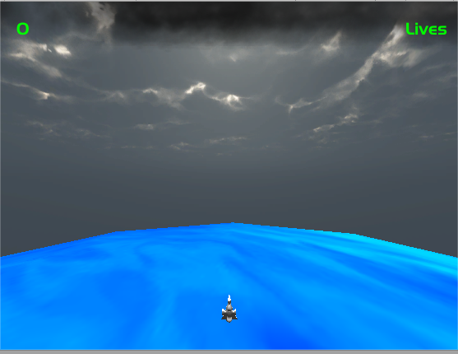
background
The default background doesn’t cut it.
To change the background just select the Main Camera and change the background color.
You can also use a texture if you are so inclined.
We’ll just keep it a grey-ish blue for now. From the Clear Flags drop down menu select the Skybox. Now we have a overcast effect.

Slide 94
Scale
If you are feeling that when playing the game maximized, the scale of the objects is too big, you can zoom out the camera by position it further in the negative Z.
Getting the proportions right in a game is very important. In our case we don’t want the spaceship to be too small, or too big. Similarly for the aliens. It needs to feel right. There is no formula as such.
Change the z position of the camera until you get the desired look and proportion for your game.

Slide 95
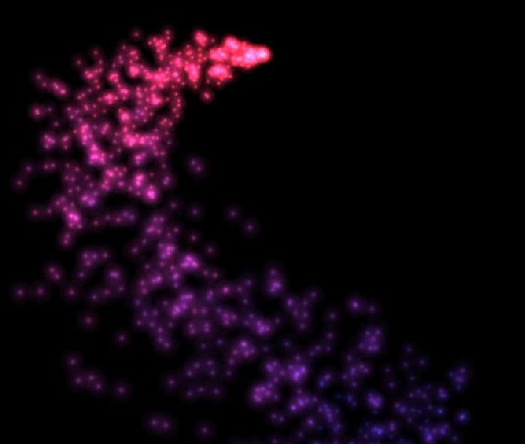
Particle Systems

Slide 96
overview
Thrusters
On Collision

Slide 97
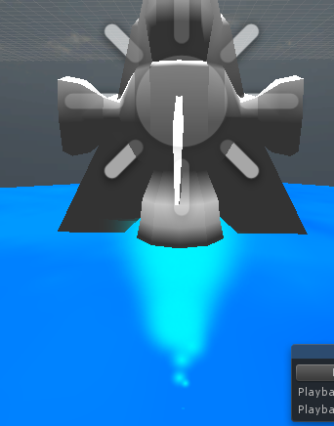
thrusters
We want the spaceship to have some thrust engines that are turned on when he pressed the right and left key.
We also want one to always be on so as to give the illusion that our spaceship is fighting gravity using a single thruster coming out of the back of the spaceship.
We can easily do said particle systems and attach them to the spaceship by making them as children of the spaceship.
Let’s start with just one particle system (the one at the bottom of the spaceship).

Slide 98
thrusters
Exercise: Experiment a bit to a create something which gives an effect of a thrust engine.
Here are some values you could try out:
Duration 1
Looping yes
Prewarm yes
Start Life 0.3
Start Speed 3
Start Size 0.8
Simulation Space Local
Max Particles 100
Start Color cyan
Emission Rate 50
Shape Cone
Radius 0.05
Length 0.1
Emit from Volume
Size over Lifetime Curve
Renderer Billboard
Normal Direction 1
Material Default-Particle
Max Particle Size 0.5

Slide 99
thrusters
Exercise: Using these same parameters create the Left and Right thruster. Make sure that you parent all 3 thrusters to your player.

Slide 100
thrusters
The next part is to turn the left thruster on when the user presses right and vice versa. Create 2 public GameObjects within your player script called thrustLeft and thrustRight respectively.
Link both particle systems through Unity and then just add this code to the up if-statements
void Update ()
{
positionX = gameObject.transform.position.x;
// when player presses arrow keys move player
if (Input.GetKey (KeyCode.LeftArrow) && positionX >= -12.5f)
{
gameObject.transform.Translate(- speed*Time.deltaTime,0,0);
thrustLeft.SetActive(false);
thrustRight.SetActive(true);
}
if (Input.GetKey (KeyCode.RightArrow) && positionX <= 12.5f)
{
gameObject.transform.Translate(speed* Time.deltaTime,0,0);
thrustLeft.SetActive(true);
thrustRight.SetActive(false);
}

Slide 101
On Collision
If you want to implement multiple hits on your aliens, you might want to have smaller explosions detonate when a missile hits an alien or the player for that matter.
You could use something similar to what we have already created using the detonator package again in order to achieve a higher degree of polish in your game.
Try to do this now.

Slide 102
Game State and GUI
Play Game

Slide 103
Overview
Level generation
Game states
The Canvas
New UI Components
Displaying the score and lives
Events
Pausing the game
Menus

Slide 104
Level Generation
There are two categories of games
Games that randomly generate their levels based on some rules
Games that load up the next level which is crafted by level designers

Slide 105
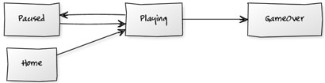
Game States
When we are playing the game we would like to have some feedback on our progress such as:
how many lives you have left and
what score you managed to achieve in the game.

Slide 106
The Canvas
When creating a User Interface in Unity, one needs to specify where the components of the user interface are going to be drawn.
This means that before we start creating a user interface we first need to have some sort of surface upon which the user interface is going to draw.
This is called the canvas.

Slide 107
The Canvas
The canvas has 3 render modes that you can choose from
Screen Space - Overlay
This render mode places UI elements on the screen rendered on top of the scene.
Screen Space - Camera
Similar to Screen Space – Overlay
The Canvas is placed a given distance in front of a specified Camera. The UI elements are rendered by this camera, which means that the Camera settings affect the appearance of the UI.
World Space
This render mode makes the Canvas behave as any other object in the scene.

Slide 108
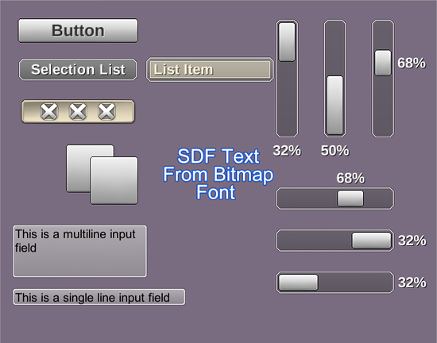
New UI Components
Panels
Buttons
Text
Images
Raw Images
Sliders
Scrollbars
Toggles
Input Fields and
Event Systems

Slide 109
Creating the Lives text
Within the bundle provided one should be able to find a HUD.ttf file.
Create a new folder in your Assets folder and call it “Fonts”
drag and drop this font into the newly created folder.
Now create a canvas component
Create a canvas and rename it to HUD
Create -> UI -> Canvas
Create a UI text and rename it to Lives
Create -> UI -> Text

Slide 110
Creating the Lives text (2)
Select the Lives Text Component and set the following properties accordingly:
Text: Lives
Character
Font: HUD
Font Style: Normal
Font Size: 14
Line Spacing: 1
Rich Text: Yes
Paragraph
Alignment: Centre, Centre
Horizontal Overflow: Wrap
Vertical Overflow: Truncate:
Best fit: Yes
Min Size: 10
Max Size: 40
Color: Lime Green
Material: none

Slide 111
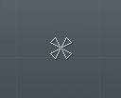
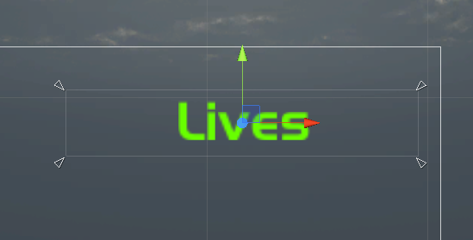
Creating the Lives text (3)
Select the move tool and place the text at the top right hand corner of the canvas.
You might have noticed that at the centre of your canvas you have a strange tool.
This has been nicknamed as the Power Flower. These are anchors
Surround your lives text with those anchors

Slide 112
Score Text
Try to do something similar to what you have just learned in order to create a text UI component for the score.

Slide 113
Update the Lives Text
Currently the Game Object which is keeping track of how many lives the player has is the player… as it should be.
However we now need to expose the health-points variable to other scripts by creating a getter method within the Player Script.
Set the tag for your player to Player and then write the following code into the Player Script:
public int getHealthPoints()
{
return healthPoints;
}

Slide 114
Update the Lives Text (2)
We now need to control the Lives UI Text component such that it would always display the number of lives left.
We would be able to do this with yet another script.
Create a LivesTextScript and attach it to the Lives UI Text Component that we have created.

Slide 115
The Lives Text Script
using UnityEngine;
using UnityEngine.UI;
using System.Collections;
public class LivesTextScript : MonoBehaviour {
GameObject player;
Text lifeText;
// Use this for initialization
void Start () {
player =
GameObject.FindGameObjectWithTag ("Player");
lifeText = GetComponent<Text> ();
}

Slide 116
The Lives Text Script
// Update is called once per frame
void Update () {
lifeText.text = "Lives: " +
player.
GetComponent<PlayerScript2>().
getHealthPoints ();
}
}

Slide 117
Update the Score Text
It would be ideal that the Game Logic script would keep track of the number of points a player has scored within the game.
Create an integer variable within the Game Logic Script and in the Start() method set this variable to zero.
Now, we need to have some functionality which would increase the score every time an enemy gets destroyed.
We would therefore need to amend the EnemyCounter() method in our Game Logic script and also add a getter method for the score points
public int getScorePoints(){
return scorePoints;
}
public void EnemyCounter()
{
numOfEnemies--;
scorePoints += 200;
}

Slide 118
Exercise
Create a script for the Score Text using a very similar approach to that we have just done with the LivesTextScript such that the score would be updated every time an alien ship gets destroyed
Hint: In the Lives Text Script you are looking of an object which is tagged as a “Player”. This time you need to look for an object which is tagged as “Game Logic”. This means that you need to tag the Game Logic object.

Slide 119
Events
At some point within the game there one is either going to win the game or the player is going to lose.
In either case we would like to give some sort of visual feedback to the user telling him/her that they have managed to win or lose the level.
The Game Object that is going to house the variables in order to see if the level is won or lost is the GameLogic.
However it is the HUD that should display the message.
We need to create 2 more UI Text components reading “You Won!” and “You Lost!” respectively.
We then need to create code such that we can calculate to see if we have entered that state.

Slide 120
Exercise
Create 2 new UI Text Components in our HUD and place them in the same position and hide them from your Scene View.
Note: To hide objects within your scene view all you need to do is select the item and uncheck the tick box at the top of the inspector view

Slide 121
Checking the Game state
Now we need to add the code to check for these states.
Add two public GameObject variables at the top of the Game Logic Script called win and lose, then add the following code.
Make sure that GameLogic:
uses UnityEngine.UI;

Slide 122
Checking the Game state (2)
...
void Update ()
{
CheckForWin ();
CheckForLoss ();
}
void CheckForLoss()
{
if(Player.GetComponent<PlayerScript2>().healthPoints <= 0)
{
Time.timeScale = 0;
lose.SetActive(true);
}
}

Slide 123
Checking the Game state (3)
void CheckForWin()
{
if(numOfEnemies <= 0)
{
Time.timeScale = 0;
win.SetActive(true);
}
}
...
Finally drag the deactivated UI Text components to the public Game Object slots exposed in the game logic script.

Slide 124
Pausing the Game
It would be a nice feature to allow the player to pause the game.
It would also be a good idea to show a menu to the player allowing him to return back to the game or possibly exit the game.
Let us create the menu that would greet the user whenever he/she decides to pause.
Within your HUD canvas create a panel which takes up about a half the height and half the width of the screen and give it a greyish colour but make it slightly transparent.
Call this panel “Pause Menu”.

Slide 125
Pausing the Game (2)
Create an Image component and set its width and height to be 300 by 50 respectively.
In the bundle provided, you should also have a logo.psd file.
Import this file into a new folder in your Assets and set it to be a sprite image.
Set the image of the UI Image component to be that of the logo you have just imported.
Name your new UI Image component as “Logo” and position it in the top centre region of your panel.
Do not forget to set the anchor points of the logo to be placed around the extremities of the logo region.
Finally parent the Logo with your Pause Menu panel.

Slide 126
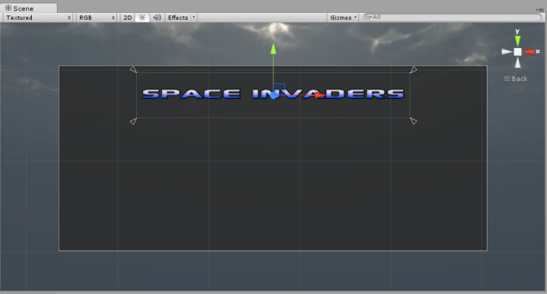

Result

Slide 127
Finalising the Pause Menu
What we need to do now is create two buttons in the pause menu.
We need one button to resume the game and a second button in order to exit the game.
Create 2 new UI button components and parent them under the pause menu also.
Use the HUD font we used earlier
Try experimenting with some colours.
A blue background and white text might be a nice for the buttons.
Once done hide the menu from the scene view.

Slide 128
Triggering the Pause Menu
This is already looking great, however we need that our pause menu is called and shown only when the pause button is pressed.
We also want the game to stop in its current position whenever the pause is triggered.
Let us assume that the pause menu will be shown whenever the user presses ‘P’ on the keyboard.
We would need to detect this input.
To do this we need to first declare a public GameObject pauseMenu variable in the Game Logic script then we need to add and amend the following code

Slide 129
Triggering the Pause Menu (2)
public void TogglePause(){
if (Time.timeScale == 1){
Time.timeScale = 0;
pauseMenu.SetActive(true);
}
else{
Time.timeScale = 1;
pauseMenu.SetActive(false);
}
}

Slide 130
Triggering the Pause Menu (3)
void Update ()
{
if (Input. GetKeyUp(KeyCode.P)){
TogglePause();
}
CheckForWin ();
CheckForLoss ();
}

Slide 131
Adding Functionality to our UI Buttons
Whenever we select the resume button we would like to continue the game.
Select the resume button from your Hierarchy view.
You should notice that you have an On Click() list.
Select the ‘+’ symbol, then drag the Game Logic object to the tab stating “None (Object)”.
Click on the dropdown menu (where you should see “No Function”) and select the GameLogic script submenu and select the TogglePause() method.

Slide 132



Adding Functionality to our UI Buttons

Slide 133
Moving on to the Exit Button
Now if you play the game and press ‘P’, you can resume the game by clicking on the Resume button.
Let us add another method to the Game Logic Script so that when you click on the Exit button you would exit the game. Add the following method in the GameLogic script:
...
public void ExitGame(){
Application.Quit();
}
...

Slide 134
Exercise
Try to add the functionality to the exit button just as we have done for the resume button.
Note: The exit button will not work in the editor, however once you deploy your game to the computer as a standalone application, then the game would exit.

Slide 135
Creating a Main Menu
So far we have only been concerned with one scene.
The scene that we have been working with is home to the game we have so far
Usually games have multiple scenes.
Each scene can be:
a level
menu or even
some sort of cinematic.
The beauty of having multiple scenes in your game is that you can load one scene from another and thus you do not have to bother with all of the other elements within the other scene.

Slide 136
Creating a Main Menu (2)
Save the current scene
Create a new scene and save it as the main menu scene.
You would realise that this new scene has absolutely nothing in it! Don’t worry. We did not lose all that we worked upon.
It is just in a different scene

Slide 137
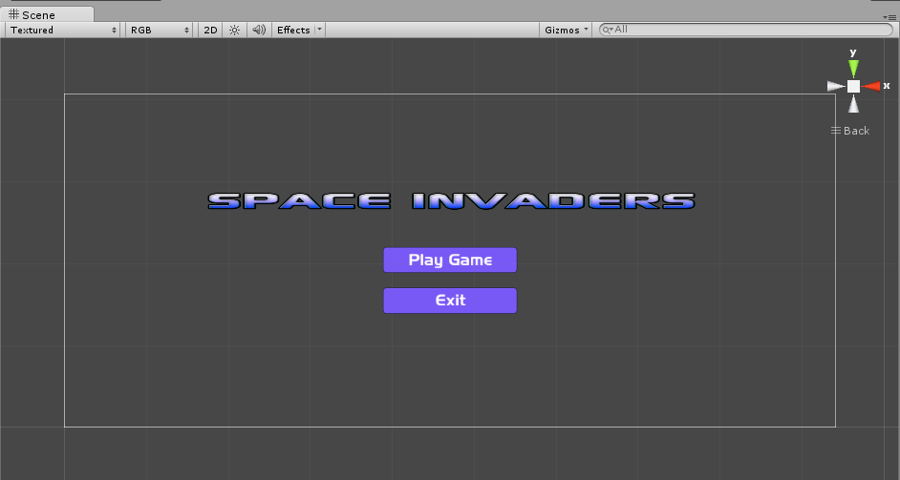
In your new Main Menu Scene
Create a new canvas system in this scene similar to that which we have done for our Pause menu

Slide 138
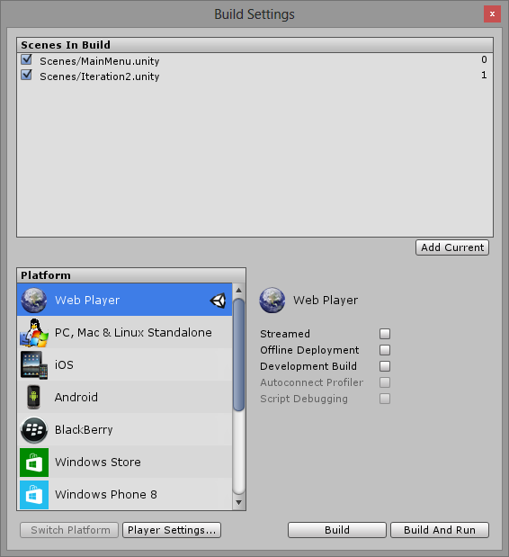
Some house Keeping
We now have to give functionality to our main menu buttons, but before we do that we need to do a bit of housekeeping.
Firstly save this scene as the main menu scene then navigate to ‘File’ and click on ‘Build Settings…’.

Slide 139
Housekeeping part (2)
Make sure that you have all the scene’s that you want in your game to be in the Scenes in Build list.
Also make sure that the Main Menu scene is at the top of the list as this is the 1st scene that you want to load as soon as you start your game.
Once you are happy with this list close the build settings.
Now we can focus on the functionality of the buttons within the main menu.
Yep, you guessed it, we need yet another script.
This time we shall be attaching it to the canvas that you have created for this menu system.
Call this script the “MainMenuScript” and write the following code in it.

Slide 140
Main Menu Script
using UnityEngine;
using System.Collections;
public class MainMenuScript : MonoBehaviour {
public void StartGame(){
Application.LoadLevel (1);
}
public void ExitGame(){
Application.Quit ();
}
}

Slide 141
Exercise
Using similar techniques as shown above, add the functionality to the “Play Game” button and the “Exit” button.
Note: We are loading level 1 because level 0 is the main menu. If at some point in the game I wish to return to the main menu, all I would need to do is load level 0.

Slide 142
Restarting the Game
Try adding some buttons when the game has ended (i.e. either when the game is won or lost) such that the player would have a choice of restarting the level or navigating back to the main menu.
Hint: Use the techniques that you have learned in these past few sections in order to do this.

Slide 143

Sound and Music

